Slide 1
Decision Making
BY
Adnan Amin
Lecturer, IMSciences
adnan.amin@imsciences.edu.pk

Slide 2
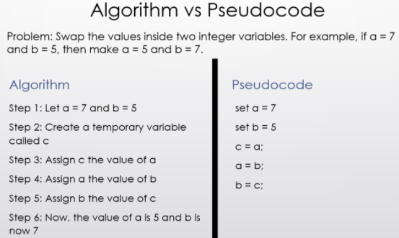
The Program Development Life Cycle
The art of designing a computer program:
Programs must be carefully designed before they are written. During the design process, programmers use tools such as pseudocode (algorithm) and flowcharts to create models of programs.
Pseudocode:
A plain high-level description of the steps in an algorithm.
A method of developing an algorithm.
Algorithm:
an algorithm is a step by step procedure to solve a given problem.

Slide 3
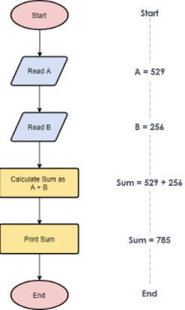
Flowchart
A flowchart is a diagram that graphically depicts the steps that take place in a program.
For example:
Problem: create a python program to read two values and calculate the sum of these values and then display the calculated sum on the screen.
A=int(input(“Read A”) # A is integer variable
B=int(input(“Read B”) # B is integer variable
Sum=A+B
Print(Sum)
Variable: A variable is a name that represents a value stored in the computer’s memory.

Slide 4
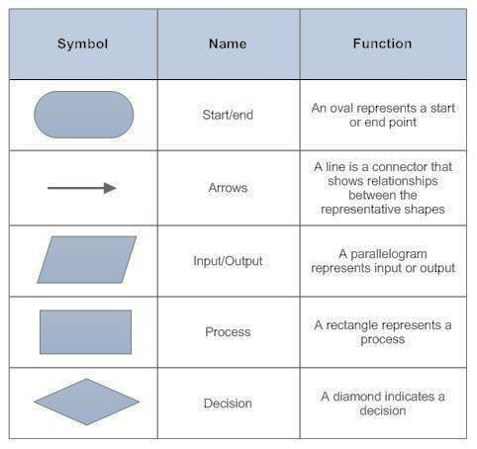
Types of symbols in the flowchart:

Slide 5
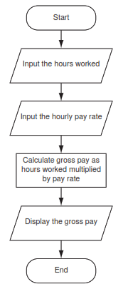
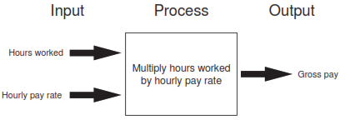
Flowchart for the pay calculating program
Input is data that the program receives. When a program receives data, it usually processes it by performing some operation with it. The result of the operation is sent out of the program as output.
You use the print function to display output in a Python program.

Slide 6
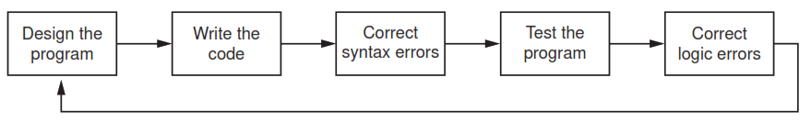
The Program Development Cycle
Design the Program:
Understand the task that the program is to perform.
Pseudocode
Determine the steps that must be taken to perform the task.
Algorithm, Flowchart
Correct syntax errors:
Violation of the language’s syntax, the compiler/interpreter will display an error. It must be corrected as per the language’s rules.
Correct logical errors:
If the program produces incorrect results, the programmer debugs the code.
Test the program:
To determine whether any logic errors exist. A logic error is a mistake that does not
prevent the program from running, but causes it to produce incorrect results.
Write the code:
begins writing code in a high-level language (python) following the proper syntax.

Slide 7
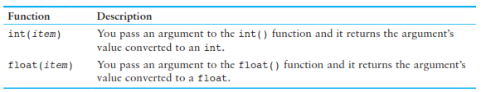
Data Conversion function (Type casting)
A=input(“Enter Value”)
The input function always returns the user’s input as a string, even if the user enters numeric data.
This can be a problem if you want to use the value in a math operation.
A=int(input(“Enter Value”)

Slide 8
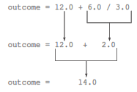
Operator precedence
outcome = 12.0 + 6.0 / 3.0
The value that will be assigned to outcome is 14.0 because the division operator has a higher precedence than the addition operator.

Slide 9
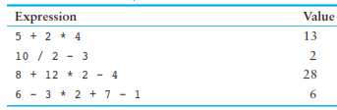
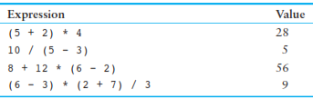
Rules for operator Precedence
1. Parentheses ( ) (left to right)
2. Exponentiation: ** (right to left) raise a number to a power
3. Multiplication, division, and remainder: * / // % (left to right)
4. Addition and subtraction: + − (left to right)
Right-to-left. For example, the expression 2**3**4 is evaluated as 2**(3**4)

Slide 10

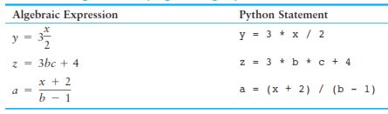
Converting Math Formulas to Programming statements
x=(a+b)/c =>

Slide 11
Formatting numbers
The format specifier is a string that contains special characters specifying how the numeric value should be formatted.
format(12345.6789, '.2f’)
.2 specifies the precision. t indicates that we want to round the number to two decimal places.
f specifies the floating-point data type,
amount_due = 5000.0
monthly_payment = amount_due / 12.0
print('The monthly payment is', monthly_payment)
print('The monthly payment is’, format(monthly_payment,’.2f’))
Output:
The monthly payment is 416.666666667
The monthly payment is 416.66
# Comma separated
>>> print(format(12345.6789, ',.2f'))
12,345.68
>>> print(format(123456789.456, ',.2f'))
123,456,789.46
# Scientific Notation
>>> print(format(12345.6789, 'e'))
1.234568e+04
>>> print(format(12345.6789, '.2e'))
1.23e+04
# Formatting a Floating-Point number as a Percentage
>>> print(format(0.5, '%'))
50.000000%
>>> print(format(0.5, '.0%'))
50%

